Slide 1

THE TUDORS
Done
By
Simran
Rigel

Slide 2
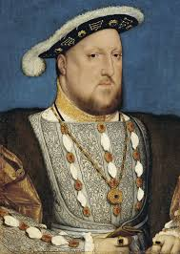
Henry VIII
Henry VIII was a very mean and selfish man. He had 6 wives. He had 3 children that lived. The children that survived were Mary 1st , Elizabeth 1st , Edward VI.
Henry VIII always wanted a son so they can rule after him but he got 2 girls and 1 boy. Unfortunately, the boy, Edward VI , died of tuberculosis after he ruled, so Elizabeth 1st had to rule the world. The first to rule after Henry VIII was Edward VI, then it was Lady Jane, then it was Mary 1st , then it was Philip II, then it was Elizabeth 1st.
Henry

Slide 3
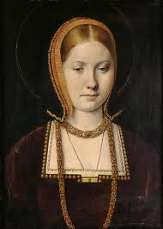
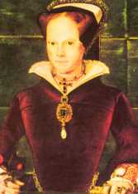
Katherine of Aragon
Katherine of Aragon was Henry VIII first wife. She gave birth to Mary 1st. Katherine was from Spain. In those times England and Spain use too have wars so Henry had to marry Katherine so they don't have wars.
Unfortunately ,because Henry fell in love with Anne Boylen he divorced Katherine. There was also another reason for why he divorced her the reason was because she gave a girl.
Katherine of Aragon
Mary

Slide 4
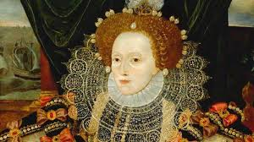
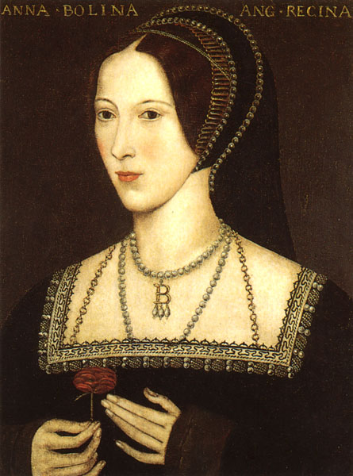
Anne Boylen
Henry divorced Katherine of Aragon and married Anne Boylen. Anne gave birth to Elizabeth 1st. After a long time after their wedding Henry thought Anne was having affairs. As well as that Henry noticed that Anne had six fingers on one hand. Henry also hated the fact that she had a girl.
After some time Anne was blindfolded and got executed.
Elizabeth
Anne

Slide 5
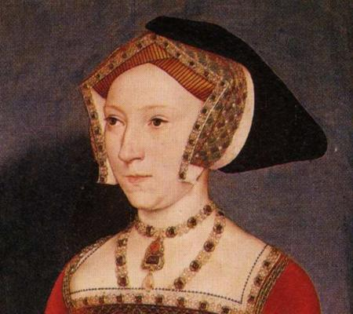
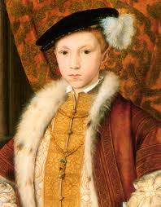
Jane Seymour
  Jane Seymour was Henry VIII third wife. Jane Seymour gave birth to Edward VI. Jane was Henry's most beloved wife. Jane died from blood poisonings. Henry was very heartbroken after she died.
Edward VI
Jane Seymour

Slide 6
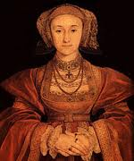
Anne of Cleves
Anne of Cleves was Henry VIII fourth wife. An artist had sent a portrait of Anne of Cleves and Henry thought she was very pretty so they, called her to marry Henry and when Henry saw her he thought she looked horrible!!!
She had a horses nose!!!
Henry didn't like her at all so he divorced her.
Anne of Cleves

Slide 7
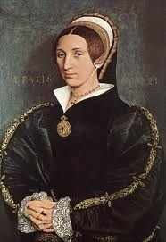
Katherine Howard
Katherine Howard was Henry VIII's fifth wife. She was Anne Boylen's cousin. She use too write love letters to other men so Henry got really angry but gave her another chance. But Katherine was interested in dancing and in other boys so Henry got even angry and got her executed like her cousin.
Katherine

Slide 8
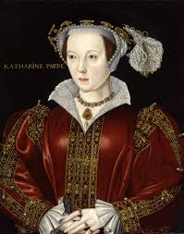
Katherine Parr
Katherine was Henry's last but not least wife. She took care of Henry while he was getting old. She also took care of the three children.
Once Henry died Katherine Parr married Thomas Seymour , Jane Seymour's brother , and on her wedding day she died.
Katherine Parr

Slide 9
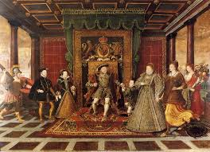
A bit more facts
Henry killed 78,000 people and Mary killed more than her father.
Elizabeth was sometimes your best friend but she could easily change into a devil.

Slide 10
HOPE YOU LEARNED LOTS!!
THANK YOU!!!!!!!!

